Slide 1
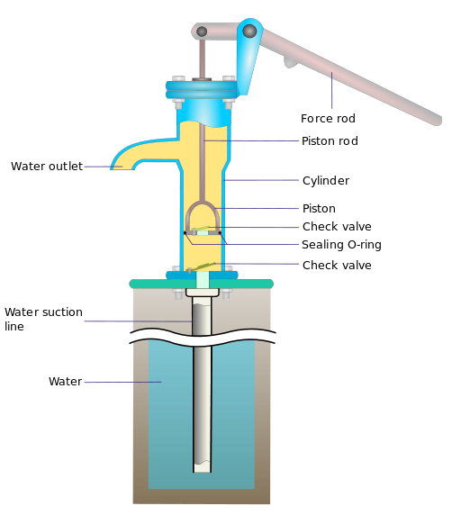
Water Pump Functionality Prediction
Winter 2025
We use tech to connect human potential and opportunity with dignity & humility
Assimagbe Albert Raphael

Slide 2
By Assimagbe Albert Raphael 📊 Using data from Taarifa and the Tanzanian Ministry of Water
Water Pump Functionality Prediction
A Data-Driven Approach for
Sustainable Water Infrastructure

Slide 3
Introduction
Access to clean and reliable water is critical for sustainable development. However, many rural water systems face frequent breakdowns due to poor maintenance and the absence of predictive monitoring systems. This project applies machine learning to predict water pump functionality, helping policymakers, NGOs, and local communities prioritize maintenance, reduce downtime, and improve service delivery.
This project leverages data science to build a predictive model that classifies water pumps into three categories:
Functional
Needs Repair
Non-Functional
Objective:
Guide preventive maintenance and,
Inform policy to reduce downtime and costs.
Key Highlights:
Data-driven prediction of Pump Functionality.
Over 59,000 records analyzed from Tanzania.
Random Forest achieved over 80% accuracy and strong recall.
Supports proactive water infrastructure planning.
Assimagbe Albert Raphael | Water Pump Functionality Project

Slide 4

Data Overview & Methodology
The project uses the DrivenData ‘Pump it Up: Data Mining the Water Table’ dataset, which contains over 59,000 records from Tanzania’s national water registry. Each record includes features on location, water quality, construction year, pump type, management, and operational status.
Key features include:
Geographic coordinates (latitude, longitude, region)
Pump characteristics (installer, extraction type, construction year)
Water quality and source type
Management scheme and population served
Target variable: pump-status-group (functional, needs repair, non-functional)
Analytical Framework:
Data Cleaning – handled missing data and inconsistencies.
Exploratory Data Analysis – identified regional and operational trends.
Feature Engineering – encoded variables, normalized numeric features.
Model Training – Random Forest, LightGBM, CatBoost, Gradient Boosting, Logistic Regression.
Evaluation – accuracy, precision, recall, F1-score.
Assimagbe Albert Raphael | Water Pump Functionality Project

Slide 5
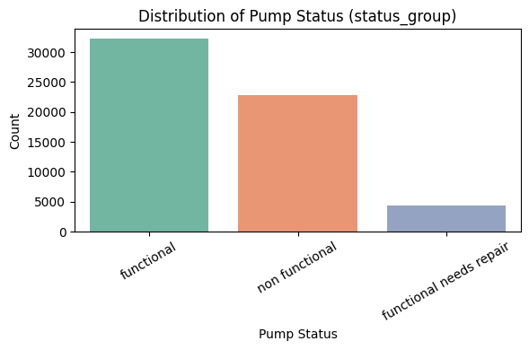
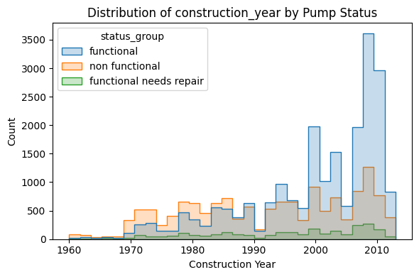
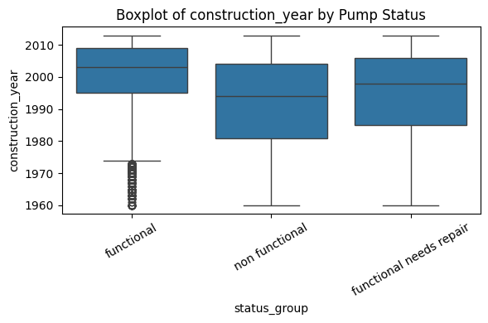
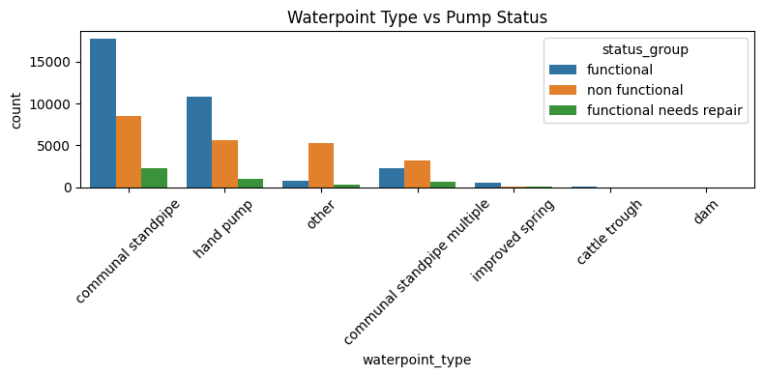
Exploratory Data Analysis (EDA)
Assimagbe Albert Raphael | Water Pump Functionality Project

Slide 6
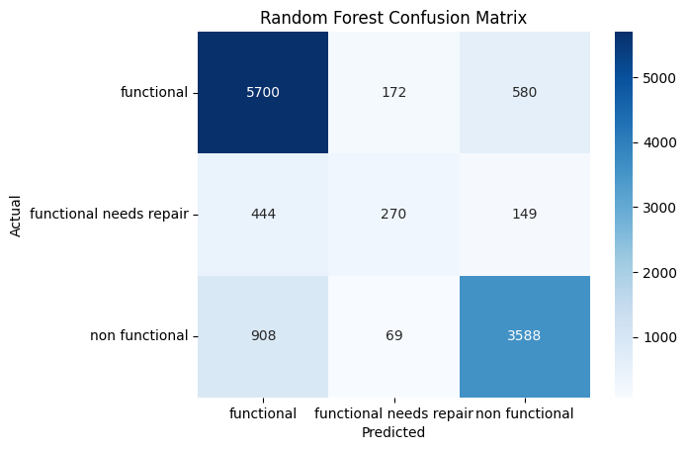
Results & Key Findings
The predictive analysis produced several valuable insights:
Best model: Random Forest with tuned parameters.
Validation accuracy: ~81%.
Strong performance for functional and non functional classes.
Weak recall for functional needs repair — likely due to class imbalance (few examples of that class).
Overall, the model is robust, generalizes well, and interpretable.
Assimagbe Albert Raphael | Water Pump Functionality Project

Slide 7
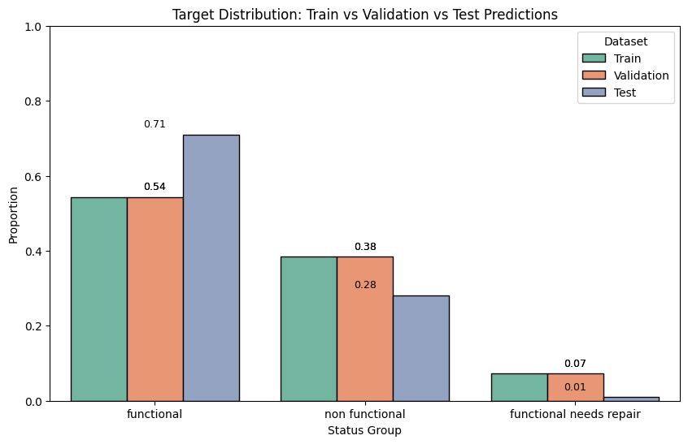
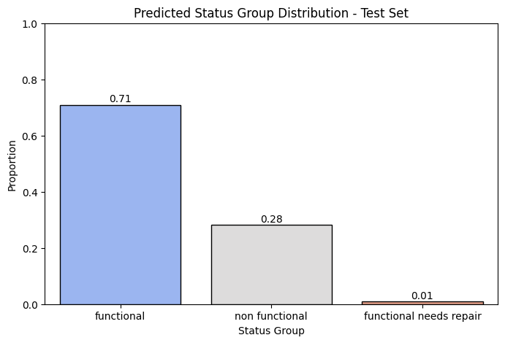
Results & Key Findings
Class | Approx. % predicted
Functional | 70.9%
Non functional | 28.1%
Functional needs repair | 0.97%
Interpretation:
The model predicts very few “needs repair” cases, which may be because that class is underrepresented in the training data (class imbalance).
So, although the model is accurate, it may not capture rare cases very well — It can be improve with class weighting or data balancing (e.g., SMOTE).
Assimagbe Albert Raphael | Water Pump Functionality Project

Slide 8
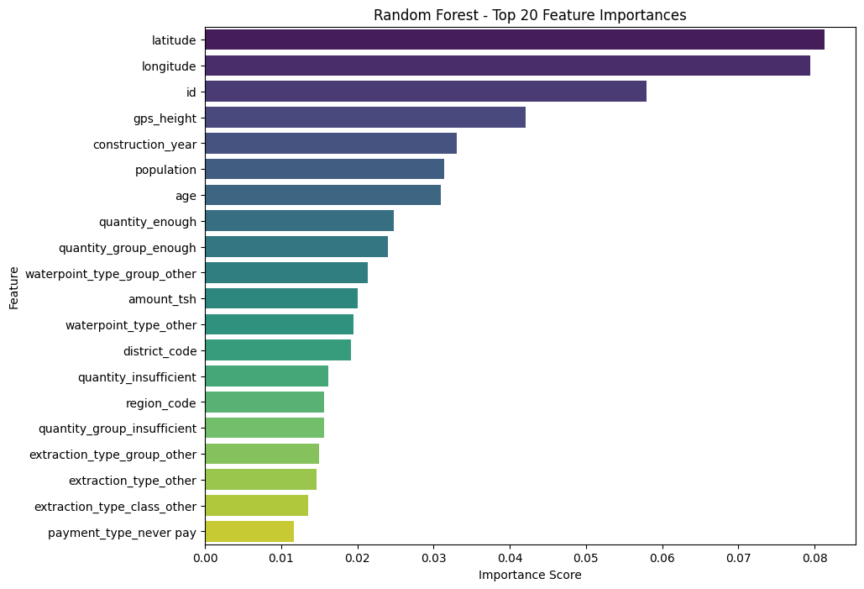
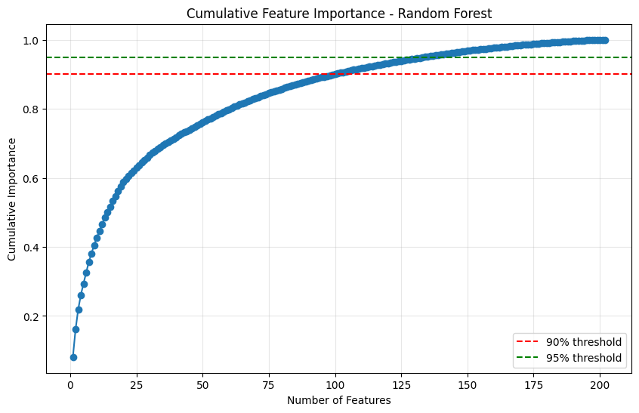
Results & Key Findings
Top Feature Importance:
Latitude
Longitude
GPS Height
Construction Year
Population
Assimagbe Albert Raphael | Water Pump Functionality Project

Slide 9
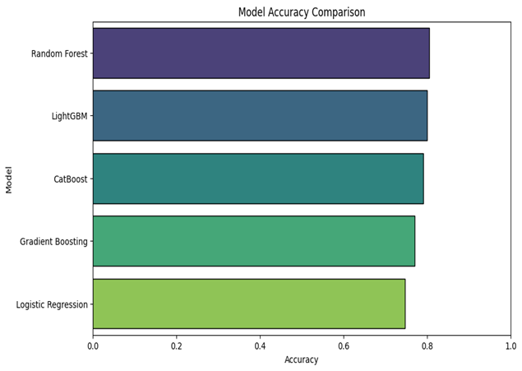
Final Summary Table
Column | Meaning | Example Interpretation
Model | The name of each machine learning model you tested. | Random Forest, LightGBM, CatBoost, Gradient Boosting, Logistic Regression.
Accuracy | The percentage of correct predictions on the validation set. | 0.804545 → 80.45% of all predictions were correct.
F1_macro | The average F1-score across all classes (treats each class equally). | 0.681711 → overall balanced performance across all classes.
F1_weighted | F1-score weighted by class frequency (accounts for class imbalance). | 0.797483 → performance adjusted for uneven class sizes.
Test_functional_Prop | The proportion of test predictions labeled “functional”. | 0.709091 → about 70.9% of pumps were predicted to be functional.
Test_non functional_Prop | The proportion of test predictions labeled “non functional”. | 0.281145 → about 28.1% predicted as non functional.
Test_functional needs repair_Prop | The proportion predicted as “functional but needs repair”. | 0.009764 → about 0.97% predicted as needing repair.
Model Accuracy comparison
Random Forest provided the most balanced performance.
Assimagbe Albert Raphael | Water Pump Functionality Project

Slide 10
Key Policy Insights & Recommendations
Policy Implications:
The results underscore the potential of predictive analytics to revolutionize rural water management. By integrating these models into national water systems, policymakers can allocate resources more efficiently, reduce pump downtime, and improve equity in water access.
Key Policy Implications:
Transition from reactive to preventive maintenance.
Integrate predictive tools into national water systems.
Strengthen data-sharing between government and NGOs.
Recommendations:
To operationalize these insights, the following steps are recommended:
Develop and deploy a national predictive maintenance dashboard.
Train local authorities and water committees on data interpretation.
Prioritize high-risk regions for preventive maintenance funding.
Encourage open-data collaborations to improve model accuracy.
Expand the approach to other critical infrastructure sectors.

Slide 11
Conclusion
Machine learning provides a viable path toward sustainable water infrastructure. By predicting failures before they occur, communities and policymakers can improve efficiency, reduce costs, and strengthen resilience.
This project supports SDG 6 — Clean Water and Sanitation — demonstrating how data-driven strategies can drive equitable development.
References
DrivenData. (2015). Pump it Up: Data Mining the Water Table. https://www.drivendata.org/competitions/7/pump-it-up-data-mining-the-water-table/
Tanzania Ministry of Water. National Water Point Mapping Data.
WHO & UNICEF. (2021). Progress on Household Drinking Water, Sanitation and Hygiene.
Assimagbe Albert Raphael | Water Pump Functionality Project

Slide 12

Thank you!
Contact Email: albertraphael96@gmail.com | LinkedIn: https://www.linkedin.com/in/assimagbe/

